Slide 1

Configuration API
March 2019
Kevin Leng
Dynatrace Guy

Slide 2
Agenda
Configuration API Overview
Create Applications using API
Create Synthetic Transactions using API
Create Dashboard using API
Q&A

Slide 3
Configuration API Overview

Slide 4
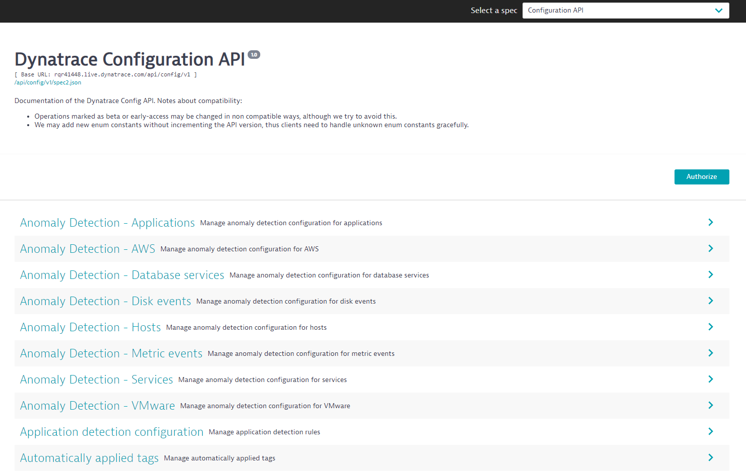
Notes:
Why config api?
Configuration as code – rather than manually create
Will see this more and more in Dynatrace – ability to switch between UI and API / CLI seamlessly…
Use this for moving config between hosts

Slide 5
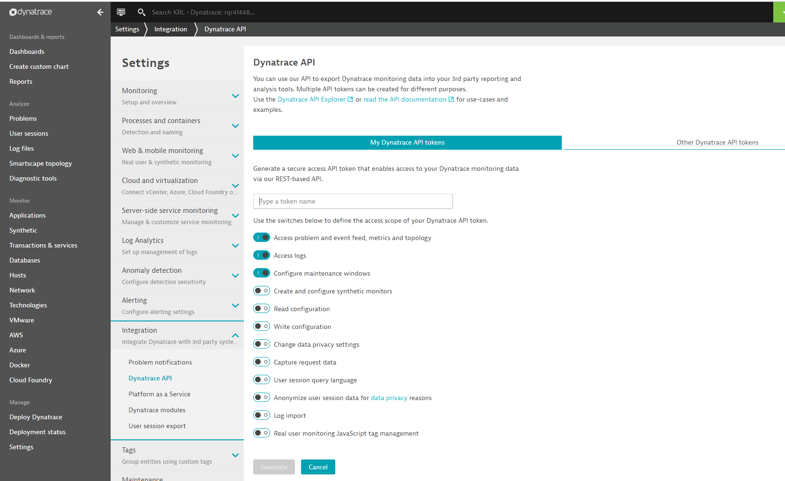

Slide 6
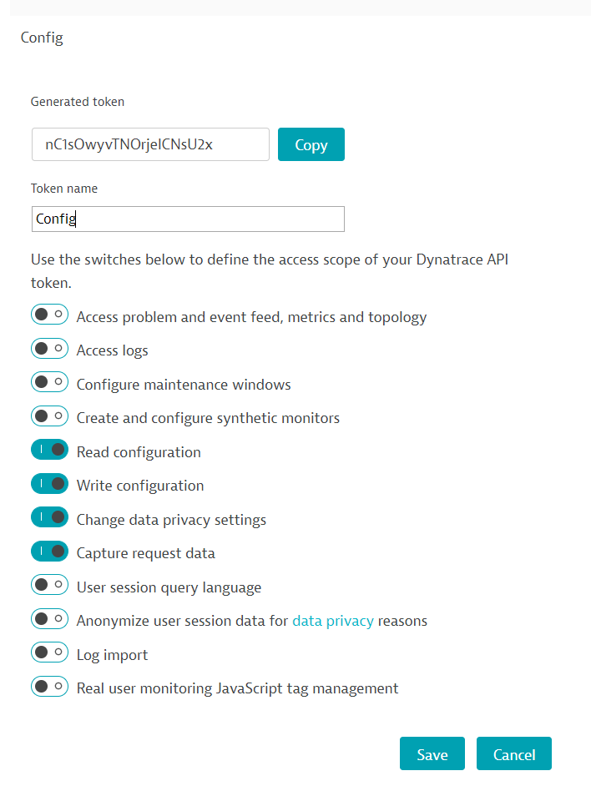
Create Configuration API Token
Settings > Integration > Dynatrace API
“Generate Token”
Provide a name and select items on the left:

Slide 7
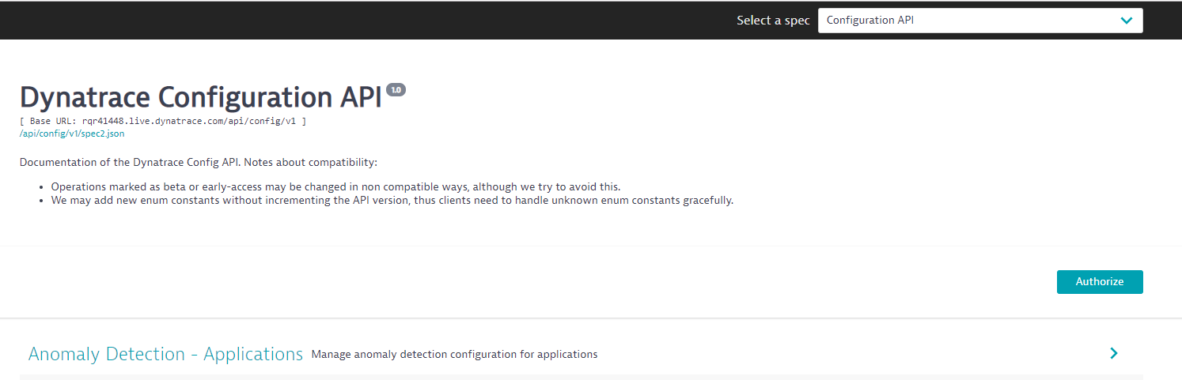
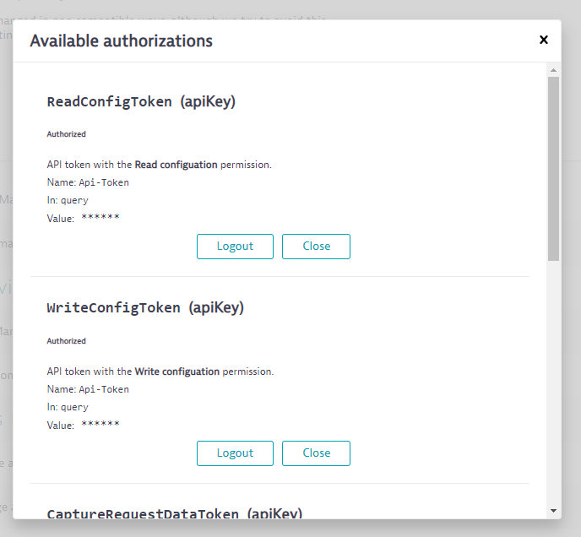
Authorise Configuration API

Slide 9
Web Applications using API

Slide 10
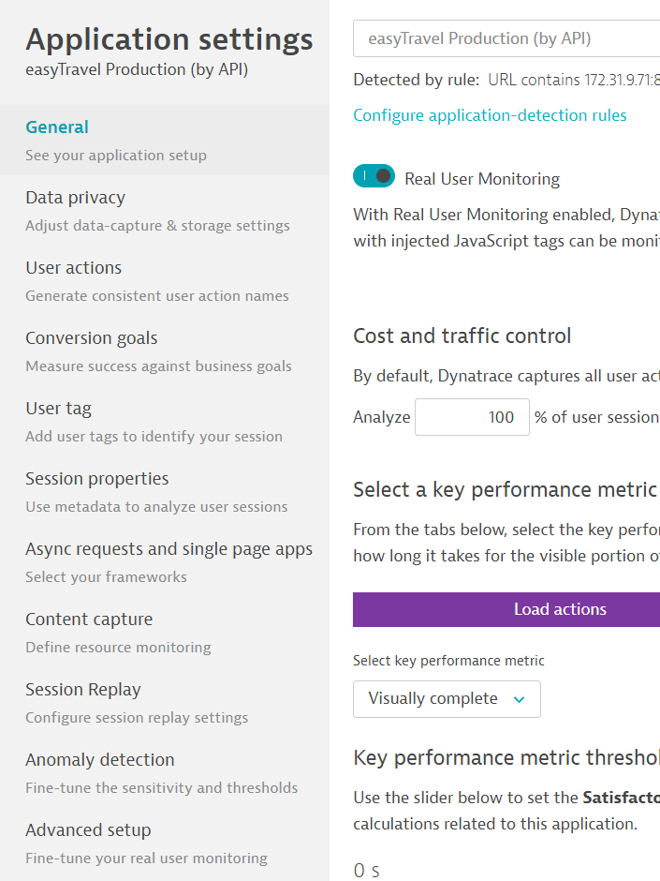
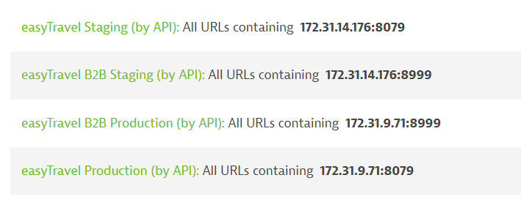
Web Applications in Dynatrace
What do we need to do to create a web application in Dynatrace and make it receive traffic?
First: Create a web application:
Second: Create Application detection rule:

Slide 11
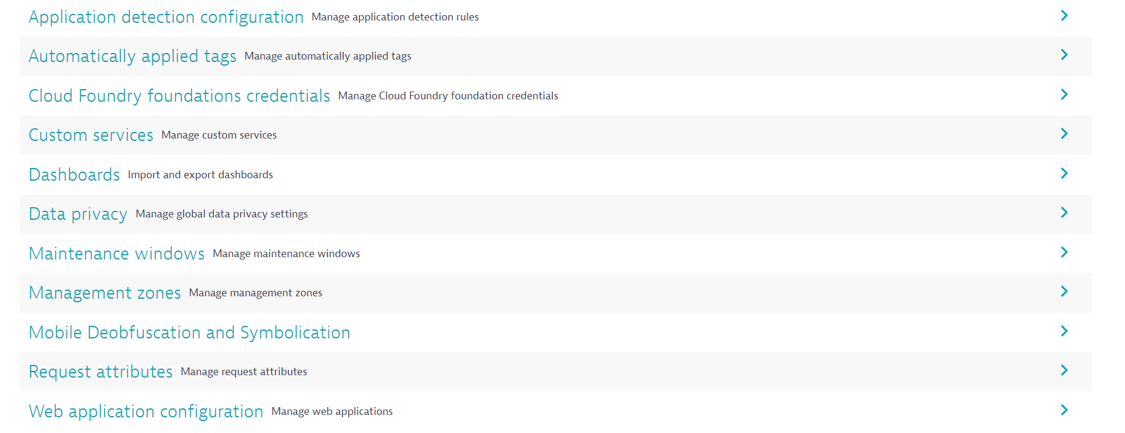

Slide 12
Web Application Configuration

Slide 13
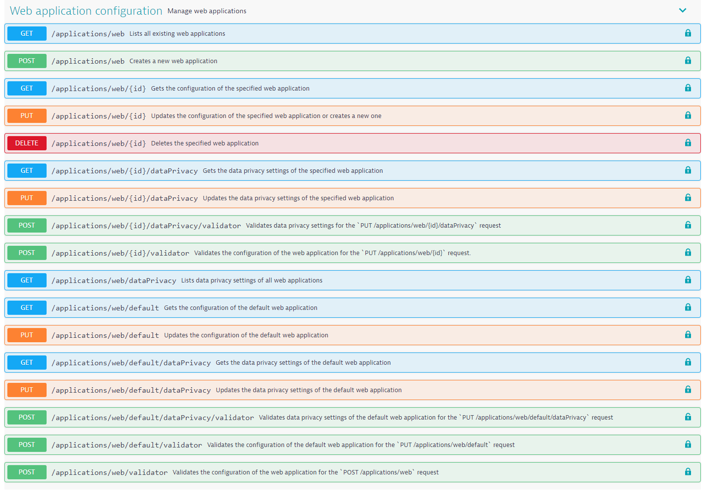

Slide 14
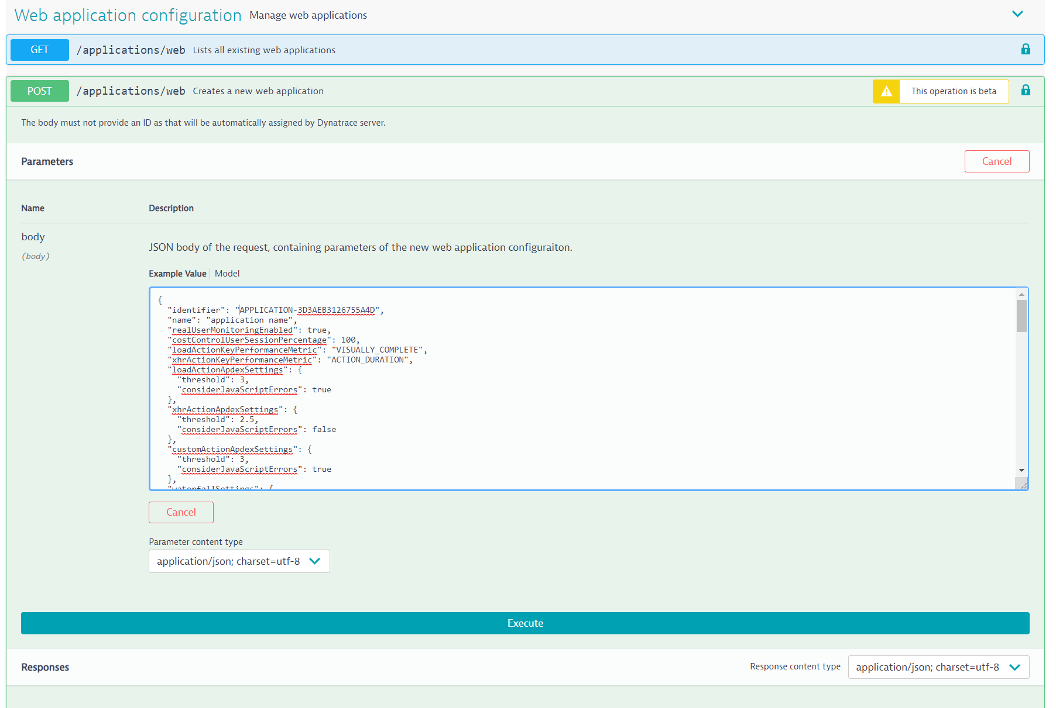

Slide 15
{
"identifier": "APPLICATION-B015199D5B489C02",
"name": "easyTravel Production (by API)",
"realUserMonitoringEnabled": true,
"costControlUserSessionPercentage": 100,
"loadActionKeyPerformanceMetric": "VISUALLY_COMPLETE",
"xhrActionKeyPerformanceMetric": "ACTION_DURATION",
"loadActionApdexSettings": {
"threshold": 3,
"considerJavaScriptErrors": true
},
"xhrActionApdexSettings": {
"threshold": 2.5,
"considerJavaScriptErrors": false
},
"customActionApdexSettings": {
"threshold": 3,
"considerJavaScriptErrors": true
},
"waterfallSettings": {
"uncompressedResourcesThreshold": 860,
"resourcesThreshold": 100000,
"resourceBrowserCachingThreshold": 50,
"slowFirstPartyResourcesThreshold": 200000,
"slowThirdPartyResourcesThreshold": 200000,
"slowCdnResourcesThreshold": 200000
},
"monitoringSettings": {
"fetchRequests": false,
"xmlHttpRequest": false,
"javaScriptFrameworkSupport": {
"angular": false,
"dojo": false,
"extJS": false,
"icefaces": true,
"jQuery": true,
"mooTools": false,
"prototype": true,
"activeXObject": false
},
"contentCapture": {
"resourceTimingSettings": {
"w3cResourceTimings": true,
"nonW3cResourceTimings": false,
"nonW3cResourceTimingsInstrumentationDelay": 50,
"resourceTimingCaptureType": "CAPTURE_FULL_DETAILS",
"resourceTimingsDomainLimit": 10
},
"javaScriptErrors": true,
"timeoutSettings": {
"timedActionSupport": false,
"temporaryActionLimit": 0,
"temporaryActionTotalTimeout": 100
},
"visuallyCompleteAndSpeedIndex": true
},
"excludeXhrRegex": "",
"injectionMode": "JAVASCRIPT_TAG",
"libraryFileLocation": "",
"monitoringDataPath": "",
"customConfigurationProperties": "",
"serverRequestPathId": "",
"secureCookieAttribute": false,
"cookiePlacementDomain": "",
"cacheControlHeaderOptimizations": true,
"advancedJavaScriptTagSettings": {
"syncBeaconFirefox": false,
"syncBeaconInternetExplorer": false,
"instrumentUnsupportedAjaxFrameworks": false,
"specialCharactersToEscape": "",
"maxActionNameLength": 100,
"maxErrorsToCapture": 10,
"additionalEventHandlers": {
"userMouseupEventForClicks": false,
"clickEventHandler": false,
"mouseupEventHandler": false,
"blurEventHandler": false,
"changeEventHandler": false,
"toStringMethod": false,
"maxDomNodesToInstrument": 5000
},
"eventWrapperSettings": {
"click": false,
"mouseUp": false,
"change": false,
"blur": false,
"touchStart": false,
"touchEnd": false
},
"globalEventCaptureSettings": {
"mouseUp": true,
"mouseDown": true,
"click": true,
"doubleClick": true,
"keyUp": true,
"keyDown": true,
"scroll": true,
"additionalEventCapturedAsUserInput": ""
}
}
}
}

Slide 16
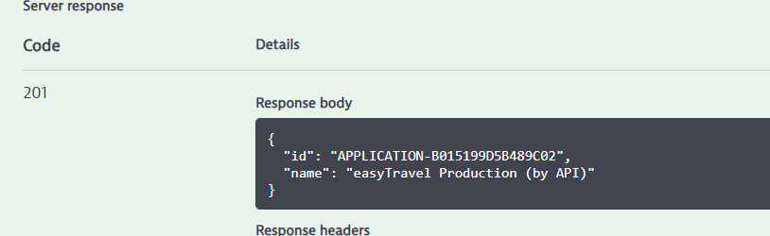

Slide 17
Application API – Hands On
https://github.com/KevLeng/ConfigurationAPI-HandsOn
Follow Steps in Lab 1 - Create the Application
This will create 4 applications:
easyTravel Production (by API)
easyTravel Staging (by API)
easyTravel B2B Production (by API)
easyTravel B2B Staging (by API)
Remember to record the application ids returned by Dynatrace!!!

Slide 18
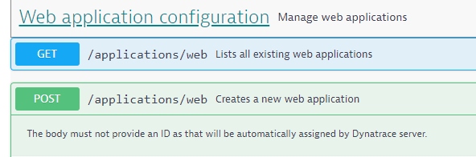
Create Web application detection rule
Hints: delete the “identifier” from the example JSON
Create Application using the following:
Select: Web application configuration > POST /applications/web (Creates a new web application)
Name: “easyTravel Production (by API)”
loadActionKeyPerformanceMetric: “ACTION_DURATION”
xhrActionKeyPerformanceMetric = “ACTION_DURATION”
Enable the following JS frameworks: xmlHttpRequest
jQuery,
ICEFaces,
Prototype
Select “Try it out”
Review available options in example provided
Hints: Use “/applications/web/validator” to test your config
Notes:
Remove ID
Set application name
"realUserMonitoringEnabled": true,
And the following:
"monitoringSettings": {
"fetchRequests": false,
"xmlHttpRequest": false,
"javaScriptFrameworkSupport": {
"angular": false,
"dojo": false,
"extJS": false,
"icefaces": true,
"jQuery": true,
"mooTools": false,
"prototype": true,
"activeXObject": false
},
Working JSON:
{
"name": "easyTravel Production (by API)",
"realUserMonitoringEnabled": true,
"costControlUserSessionPercentage": 100,
"loadActionKeyPerformanceMetric": "VISUALLY_COMPLETE",
"xhrActionKeyPerformanceMetric": "ACTION_DURATION",
"loadActionApdexSettings": {
"threshold": 3,
"considerJavaScriptErrors": true
},
"xhrActionApdexSettings": {
"threshold": 2.5,
"considerJavaScriptErrors": false
},
"customActionApdexSettings": {
"threshold": 3,
"considerJavaScriptErrors": true
},
"waterfallSettings": {
"uncompressedResourcesThreshold": 860,
"resourcesThreshold": 100000,
"resourceBrowserCachingThreshold": 50,
"slowFirstPartyResourcesThreshold": 200000,
"slowThirdPartyResourcesThreshold": 200000,
"slowCdnResourcesThreshold": 200000
},
"monitoringSettings": {
"fetchRequests": false,
"xmlHttpRequest": false,
"javaScriptFrameworkSupport": {
"angular": false,
"dojo": false,
"extJS": false,
"icefaces": true,
"jQuery": true,
"mooTools": false,
"prototype": true,
"activeXObject": false
},
"contentCapture": {
"resourceTimingSettings": {
"w3cResourceTimings": true,
"nonW3cResourceTimings": false,
"nonW3cResourceTimingsInstrumentationDelay": 50,
"resourceTimingCaptureType": "CAPTURE_FULL_DETAILS",
"resourceTimingsDomainLimit": 10
},
"javaScriptErrors": true,
"timeoutSettings": {
"timedActionSupport": false,
"temporaryActionLimit": 0,
"temporaryActionTotalTimeout": 100
},
"visuallyCompleteAndSpeedIndex": true
},
"excludeXhrRegex": "",
"injectionMode": "JAVASCRIPT_TAG",
"libraryFileLocation": "",
"monitoringDataPath": "",
"customConfigurationProperties": "",
"serverRequestPathId": "",
"secureCookieAttribute": false,
"cookiePlacementDomain": "",
"cacheControlHeaderOptimizations": true,
"advancedJavaScriptTagSettings": {
"syncBeaconFirefox": false,
"syncBeaconInternetExplorer": false,
"instrumentUnsupportedAjaxFrameworks": false,
"specialCharactersToEscape": "",
"maxActionNameLength": 100,
"maxErrorsToCapture": 10,
"additionalEventHandlers": {
"userMouseupEventForClicks": false,
"clickEventHandler": false,
"mouseupEventHandler": false,
"blurEventHandler": false,
"changeEventHandler": false,
"toStringMethod": false,
"maxDomNodesToInstrument": 5000
},
"eventWrapperSettings": {
"click": false,
"mouseUp": false,
"change": false,
"blur": false,
"touchStart": false,
"touchEnd": false
},
"globalEventCaptureSettings": {
"mouseUp": true,
"mouseDown": true,
"click": true,
"doubleClick": true,
"keyUp": true,
"keyDown": true,
"scroll": true,
"additionalEventCapturedAsUserInput": ""
}
}
}
}
curl -X POST "https://jlp305.dynatrace-managed.com/e/7570960d-4473-4a06-bb2f-37e9f53294b6/api/config/v1/applications/web?Api-Token=yIFtWuz8QgG_H42-CzG04" -H "accept: application/json; charset=utf-8" -H "Content-Type: application/json; charset=utf-8" -d "{ \"name\": \"easyTravel Production (by API)\", \"realUserMonitoringEnabled\": true, \"costControlUserSessionPercentage\": 100, \"loadActionKeyPerformanceMetric\": \"VISUALLY_COMPLETE\", \"xhrActionKeyPerformanceMetric\": \"ACTION_DURATION\", \"loadActionApdexSettings\": { \"threshold\": 3, \"considerJavaScriptErrors\": true }, \"xhrActionApdexSettings\": { \"threshold\": 2.5, \"considerJavaScriptErrors\": false }, \"customActionApdexSettings\": { \"threshold\": 3, \"considerJavaScriptErrors\": true }, \"waterfallSettings\": { \"uncompressedResourcesThreshold\": 860, \"resourcesThreshold\": 100000, \"resourceBrowserCachingThreshold\": 50, \"slowFirstPartyResourcesThreshold\": 200000, \"slowThirdPartyResourcesThreshold\": 200000, \"slowCdnResourcesThreshold\": 200000 }, \"monitoringSettings\": { \"fetchRequests\": false, \"xmlHttpRequest\": true, \"javaScriptFrameworkSupport\": { \"angular\": false, \"dojo\": false, \"extJS\": false, \"icefaces\": true, \"jQuery\": true, \"mooTools\": false, \"prototype\": true, \"activeXObject\": false }, \"contentCapture\": { \"resourceTimingSettings\": { \"w3cResourceTimings\": true, \"nonW3cResourceTimings\": false, \"nonW3cResourceTimingsInstrumentationDelay\": 50, \"resourceTimingCaptureType\": \"CAPTURE_FULL_DETAILS\", \"resourceTimingsDomainLimit\": 10 }, \"javaScriptErrors\": true, \"timeoutSettings\": { \"timedActionSupport\": false, \"temporaryActionLimit\": 0, \"temporaryActionTotalTimeout\": 100 }, \"visuallyCompleteAndSpeedIndex\": true }, \"excludeXhrRegex\": \"\", \"injectionMode\": \"JAVASCRIPT_TAG\", \"libraryFileLocation\": \"\", \"monitoringDataPath\": \"\", \"customConfigurationProperties\": \"\", \"serverRequestPathId\": \"\", \"secureCookieAttribute\": false, \"cookiePlacementDomain\": \"\", \"cacheControlHeaderOptimizations\": true, \"advancedJavaScriptTagSettings\": { \"syncBeaconFirefox\": false, \"syncBeaconInternetExplorer\": false, \"instrumentUnsupportedAjaxFrameworks\": false, \"specialCharactersToEscape\": \"\", \"maxActionNameLength\": 100, \"maxErrorsToCapture\": 10, \"additionalEventHandlers\": { \"userMouseupEventForClicks\": false, \"clickEventHandler\": false, \"mouseupEventHandler\": false, \"blurEventHandler\": false, \"changeEventHandler\": false, \"toStringMethod\": false, \"maxDomNodesToInstrument\": 5000 }, \"eventWrapperSettings\": { \"click\": false, \"mouseUp\": false, \"change\": false, \"blur\": false, \"touchStart\": false, \"touchEnd\": false }, \"globalEventCaptureSettings\": { \"mouseUp\": true, \"mouseDown\": true, \"click\": true, \"doubleClick\": true, \"keyUp\": true, \"keyDown\": true, \"scroll\": true, \"additionalEventCapturedAsUserInput\": \"\" } } }}"

Slide 19
Walk through….

Slide 20
{
"identifier": "APPLICATION-B015199D5B489C02",
"name": "easyTravel Production (by API)",
"realUserMonitoringEnabled": true,
"costControlUserSessionPercentage": 100,
"loadActionKeyPerformanceMetric": " ACTION_DURATION",
"xhrActionKeyPerformanceMetric": "ACTION_DURATION",
"loadActionApdexSettings": {
"threshold": 3,
"considerJavaScriptErrors": true
},
"xhrActionApdexSettings": {
"threshold": 2.5,
"considerJavaScriptErrors": false
},
"customActionApdexSettings": {
"threshold": 3,
"considerJavaScriptErrors": true
},
"waterfallSettings": {
"uncompressedResourcesThreshold": 860,
"resourcesThreshold": 100000,
"resourceBrowserCachingThreshold": 50,
"slowFirstPartyResourcesThreshold": 200000,
"slowThirdPartyResourcesThreshold": 200000,
"slowCdnResourcesThreshold": 200000
},
"monitoringSettings": {
"fetchRequests": false,
"xmlHttpRequest": true,
"javaScriptFrameworkSupport": {
"angular": false,
"dojo": false,
"extJS": false,
"icefaces": true,
"jQuery": true,
"mooTools": false,
"prototype": true,
"activeXObject": false
},
"contentCapture": {
"resourceTimingSettings": {
"w3cResourceTimings": true,
"nonW3cResourceTimings": false,
"nonW3cResourceTimingsInstrumentationDelay": 50,
"resourceTimingCaptureType": "CAPTURE_FULL_DETAILS",
"resourceTimingsDomainLimit": 10
},
"javaScriptErrors": true,
"timeoutSettings": {
"timedActionSupport": false,
"temporaryActionLimit": 0,
"temporaryActionTotalTimeout": 100
},
"visuallyCompleteAndSpeedIndex": true
},
"excludeXhrRegex": "",
"injectionMode": "JAVASCRIPT_TAG",
"libraryFileLocation": "",
"monitoringDataPath": "",
"customConfigurationProperties": "",
"serverRequestPathId": "",
"secureCookieAttribute": false,
"cookiePlacementDomain": "",
"cacheControlHeaderOptimizations": true,
"advancedJavaScriptTagSettings": {
"syncBeaconFirefox": false,
"syncBeaconInternetExplorer": false,
"instrumentUnsupportedAjaxFrameworks": false,
"specialCharactersToEscape": "",
"maxActionNameLength": 100,
"maxErrorsToCapture": 10,
"additionalEventHandlers": {
"userMouseupEventForClicks": false,
"clickEventHandler": false,
"mouseupEventHandler": false,
"blurEventHandler": false,
"changeEventHandler": false,
"toStringMethod": false,
"maxDomNodesToInstrument": 5000
},
"eventWrapperSettings": {
"click": false,
"mouseUp": false,
"change": false,
"blur": false,
"touchStart": false,
"touchEnd": false
},
"globalEventCaptureSettings": {
"mouseUp": true,
"mouseDown": true,
"click": true,
"doubleClick": true,
"keyUp": true,
"keyDown": true,
"scroll": true,
"additionalEventCapturedAsUserInput": ""
}
}
}
}

Slide 21
Web Application Detection

Slide 22
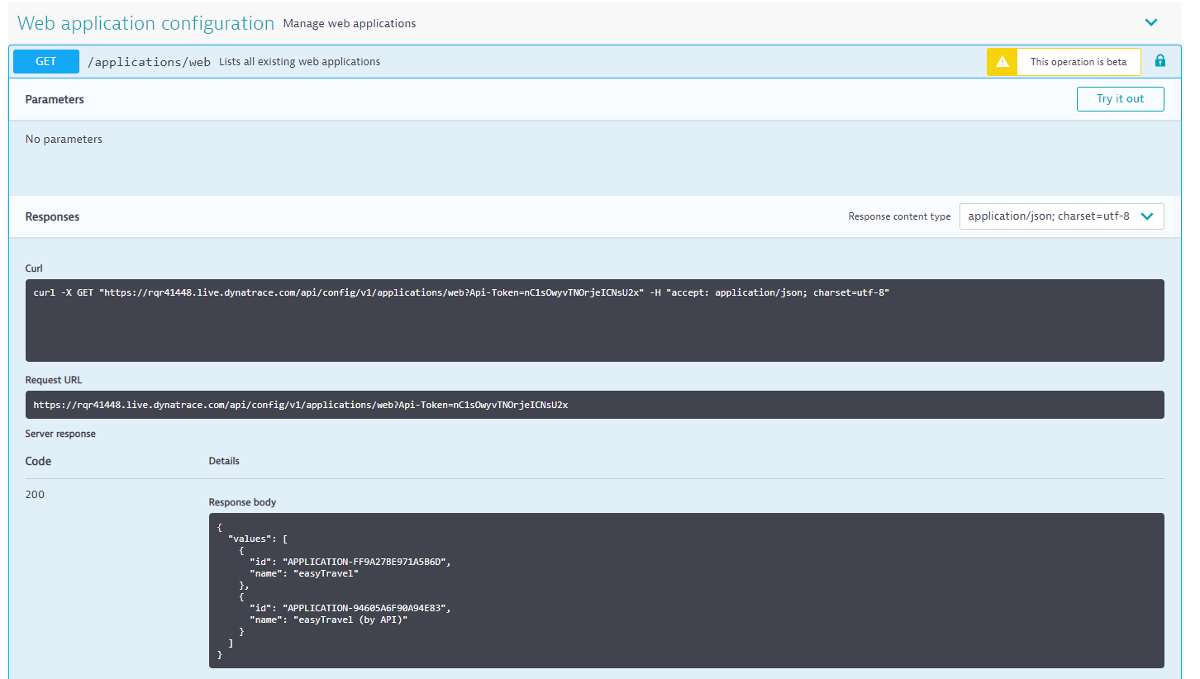
Query exiting web applications, your new application should appear.
Copy this id for use in the next section
Notes:
{ "values": [ { "id": "APPLICATION-FF9A27BE971A5B6D", "name": "easyTravel" }, { "id": "APPLICATION-94605A6F90A94E83", "name": "easyTravel (by API)" } ] }

Slide 23
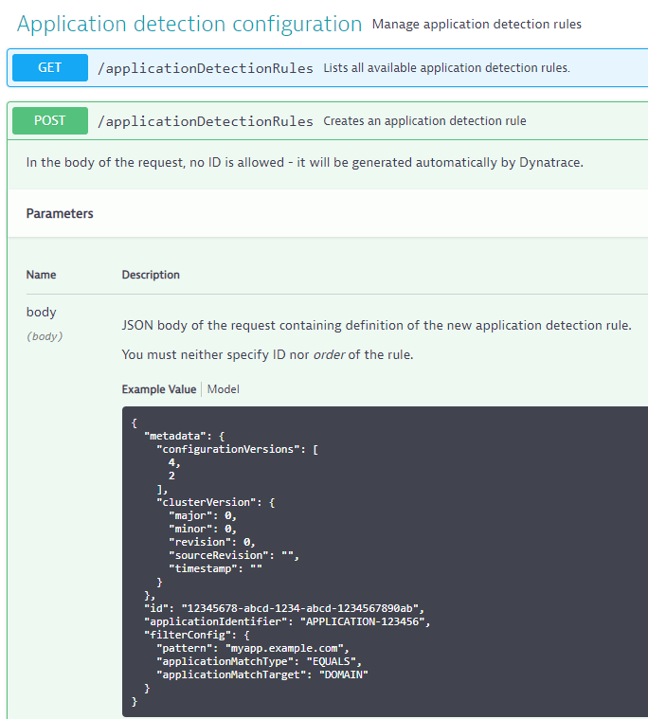
Application Detection Rules
Now we have our application definition, we need to add detection rules to push traffic to it.
{
"applicationIdentifier": “YOUR-Application-ID",
"filterConfig": {
"pattern": “ipaddress:8079,
"applicationMatchType": “CONTAINS",
"applicationMatchTarget": “URL"
}
}
applicationMatchType: BEGINS_WITH, CONTAINS, ENDS_WITH, EQUALS, MATCHES
applicationMatchTarget: DOMAIN, URL

Slide 24
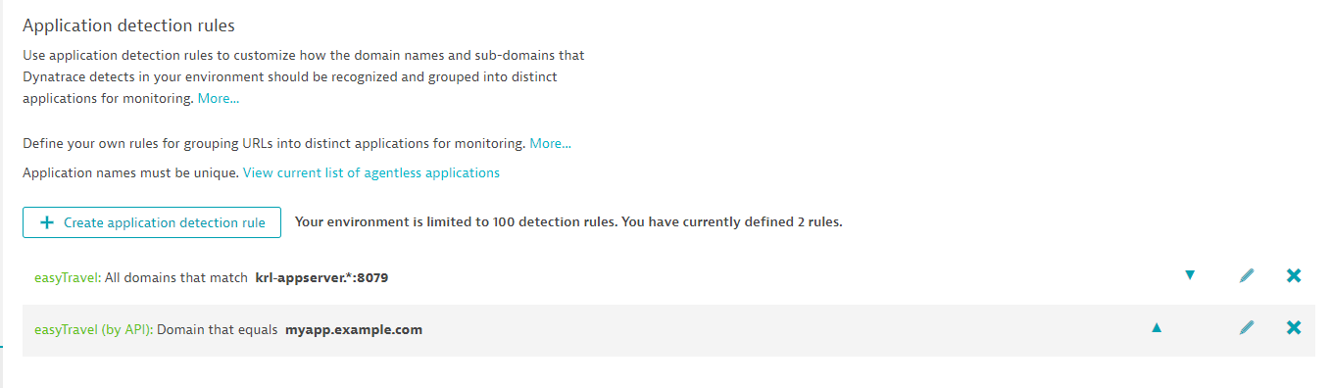
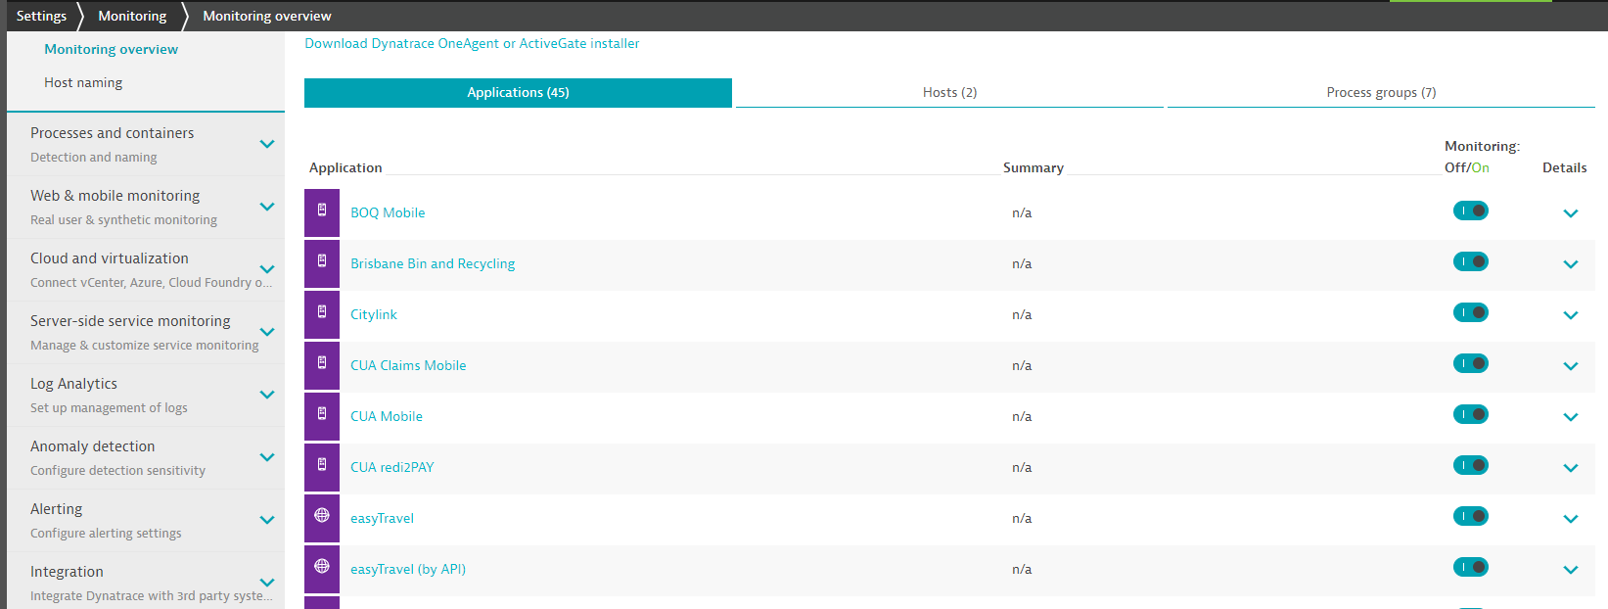
Application Created
Notes:
{ "applicationIdentifier": "APPLICATION-94605A6F90A94E83",
"filterConfig": {
"pattern": "myapp.example.com",
"applicationMatchType": "EQUALS",
"applicationMatchTarget": "DOMAIN" }
}

Slide 25
Create the following Applications
Production
Application: easyTravel Production (by API)
Enable: jQuery, ICEFaces and Prototype JS frameworks
Rule: Ip Address (of production server):8079
Application easyTravel B2B Production (by API)
No JS Libraries Activated
Rule: IP Address (of production server):8999
Staging
Application: easyTravel Staging (by API)
Enable: xmlHttpRequest, jQuery, ICEFaces and Prototype JS frameworks
Rule: Ip Address (of staging server):8079
Application easyTravel B2B Staging (by API)
No JS Libraries Activated
Rule: IP Address (of Staging server):8999
Hints: Use internal IP addresses for rule definitions
Notes:
{ "id": "APPLICATION-07B34DBDCB21C115", "name": "easyTravel B2B Production (by API)" }
{ "id": "APPLICATION-538A0760B2DDDB55", "name": "easyTravel B2B Staging (by API)" }
{ "id": "APPLICATION-E6DFC668E16F74C0", "name": "easyTravel Staging (by API)" }
172.31.14.176

Slide 26
Application API – Hands On
https://github.com/KevLeng/ConfigurationAPI-HandsOn
Follow Steps in Lab 1 - Create the Application Detection Rules
Remember to record the application ids returned by Dynatrace!!!

Slide 27
Walk through….

Slide 28
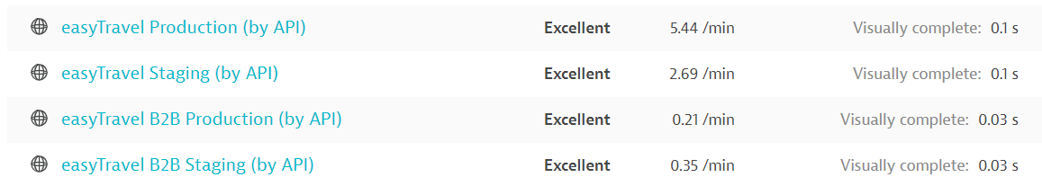
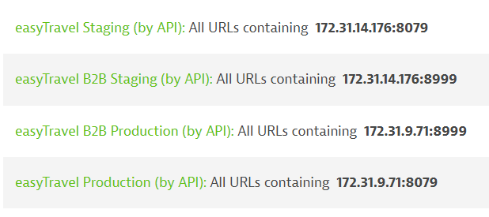
Completed!

Slide 29
Synthetic API
Notes:
Last bootcamp we looked at pushing external syth data into Dynatrace.
This time we’ll create a couple of transactions.

Slide 30
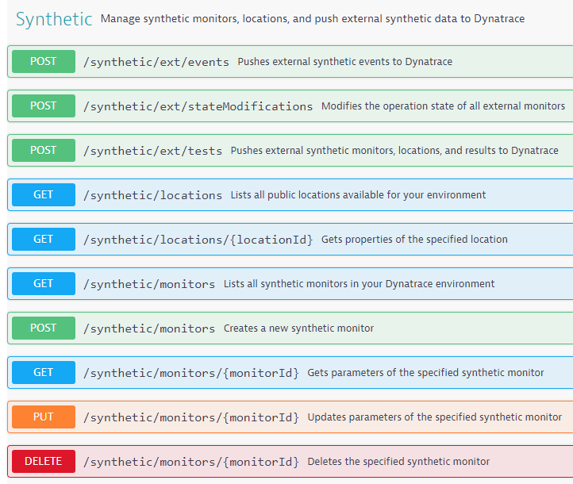

Synthetic API
We are going to create via:
Single Page Browser Check
Multi Step Transaction
For each, we’ll need an API token so please create one now:
View API’s available here (in Environment API):
Notes:
Single Page Browser Check: we are going to do this as a worked example together.

Slide 31
{
"name": "easyTravel Production - Homepage",
"frequencyMin": 15,
"enabled": true,
"type": "BROWSER",
"script": "",
"locations": [
"GEOLOCATION-191EF52906549983",
"GEOLOCATION-2FD31C834DE4D601"
],
"anomalyDetection": {
"outageHandling": {
"globalOutage": true,
"localOutage": false,
"localOutagePolicy": {
"affectedLocations": 1,
"consecutiveRuns": 3
}
},
"loadingTimeThresholds": {
"enabled": false,
"thresholds": []
}
},
"tags": [],
"managementZones": []
}
Name
Frequency
Locations
Notes:
Quickest way to disover the JSON format is to create one manually then query… this is what I have done here.
I’ve left out script here on purpose.

Slide 32
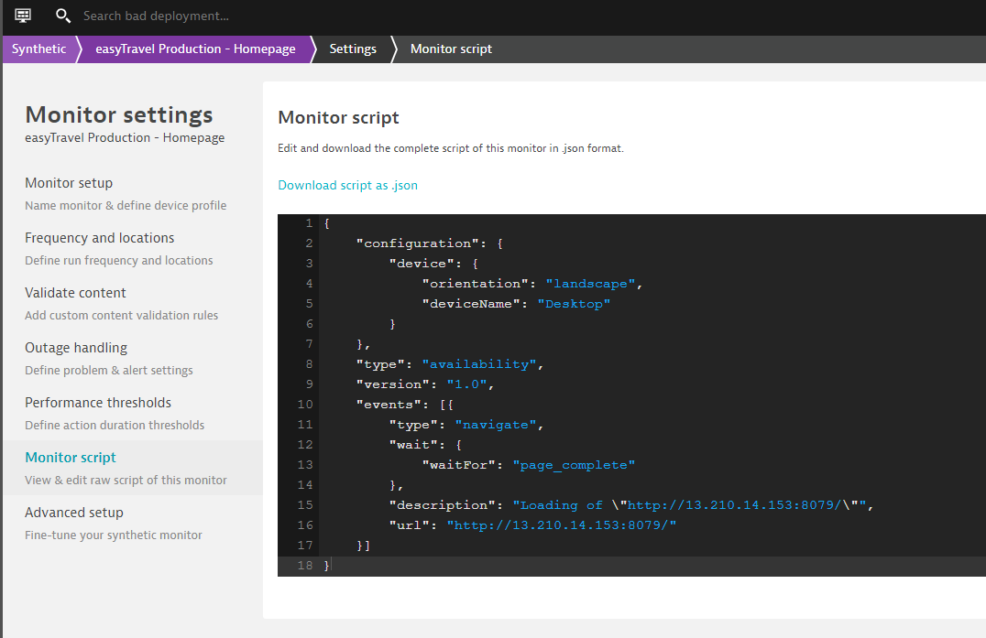
Replace the with Your production IP addresses
This JSON will be provided via Slack…
Notes:
This is script…

Slide 33
Script needs to be “Escaped”
Script JSON needs to be provided as a string
For this reason we need to “escape” the script JSON
Escaped JSON string is removing traces of offending characters that could prevent parsing.
For example: Double quote “ is replaced with \“
You can attempt this manually, if you google “escape json”, there are lots of websites that will do this for you:
https://www.freeformatter.com/json-escape.html
https://codebeautify.org/json-escape-unescape
Use one of these sites to “escape” you script JSON, you will end up with something like this:
{\r\n \"configuration\": {\r\n \"device\": {\r\n \"orientation\": \"landscape\",\r\n \"deviceName\": \"Desktop\"\r\n }\r\n },\r\n \"type\": \"availability\",\r\n \"version\": \"1.0\",\r\n \"events\": [{\r\n \"type\": \"navigate\",\r\n \"wait\": {\r\n \"waitFor\": \"page_complete\"\r\n },\r\n \"description\": \"Loading of \\\"http:\/\/13.210.14.153:8079\/\\\"\",\r\n \"url\": \"http:\/\/13.210.14.153:8079\/\"\r\n }]\r\n}

Slide 34
Synthetic Browser Check via API
{
"name": "easyTravel Production - Homepage",
"frequencyMin": 15,
"enabled": true,
"type": "BROWSER",
"script": "{\r\n \"configuration\": {\r\n \"device\": {\r\n \"orientation\": \"landscape\",\r\n \"deviceName\": \"Desktop\"\r\n }\r\n },\r\n \"type\": \"availability\",\r\n \"version\": \"1.0\",\r\n \"events\": [{\r\n \"type\": \"navigate\",\r\n \"wait\": {\r\n \"waitFor\": \"page_complete\"\r\n },\r\n \"description\": \"Loading of \\\"http:\/\/13.210.14.153:8079\/\\\"\",\r\n \"url\": \"http:\/\/13.210.14.153:8079\/\"\r\n }]\r\n}",
"locations": [
"GEOLOCATION-191EF52906549983",
"GEOLOCATION-2FD31C834DE4D601"
],
"anomalyDetection": {
"outageHandling": {
"globalOutage": true,
"localOutage": false,
"localOutagePolicy": {
"affectedLocations": 1,
"consecutiveRuns": 3
}
},
"loadingTimeThresholds": {
"enabled": false,
"thresholds": []
}
},
"tags": [],
"managementZones": []
}
Use this JSON to create your Synthetic Browser check.
Confirm you Synthetic Browser check is created through the UI
Together they look like this

Slide 35
Synthetic Multistep Browser Check via API
{
"configuration": {
"device": {
"orientation": "landscape",
"deviceName": "Desktop"
}
},
"type": "clickpath",
"version": "1.0",
"events": [{
"type": "navigate",
"wait": {
"waitFor": "page_complete"
},
"description": "Loading of \"http://13.210.14.153:8079/\"",
"url": "http://13.210.14.153:8079/"
}, {
"type": "click",
"wait": {
"waitFor": "network"
},
"target": {
You will be sent a Multi Step Script JSON:
Modify the IP addresses to point to your Production environment
“Escape” the Script JSON.
Merge with the API JSON – change name to “easyTravel Production - Multi Step”
Use resulting JSON to create your Synthetic Multistep Browser check.
Confirm you Synthetic Browser check is created through the UI
Example Script JSON

Slide 36
Synthetic API – Hands On
https://github.com/KevLeng/ConfigurationAPI-HandsOn
Follow Steps in Lab 2 – Synthetic API
Remember to record the Synthetic ids returned by Dynatrace!!!

Slide 37
Walk through….

Slide 38
Dashboard API

Slide 39
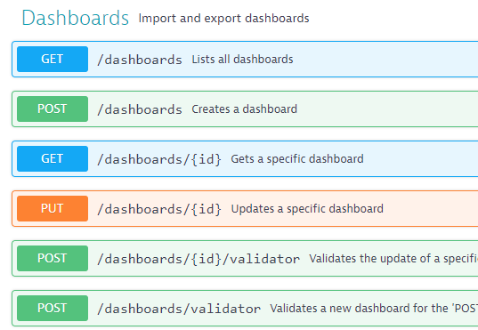
Dashboards API
{
"metadata": {
"clusterVersion": "1.162.140.20190225-132002",
"configurationVersions": [
2
]
},
"id": "cd3dbb72-bd6b-4d3a-966b-ca07741b669b",
"dashboardMetadata": {
"name": "Executive Overview",
"owner": "admin",
"timeframe": "l_2_HOURS",
"managementZone": null
},
"tiles": [
{
"name": "Top web applications",
"tileType": "APPLICATIONS_MOST_ACTIVE",
"configured": true,
"bounds": {
"top": 494,
"left": 0,
"width": 304,
"height": 304
},
"useComparisionTimeframe": false,
"managementZone": null
We can now export / import via API
Dashboards are in JSON format
Contain all details needed or the new environment to build and display the dashboards
Example Script JSON

Slide 40
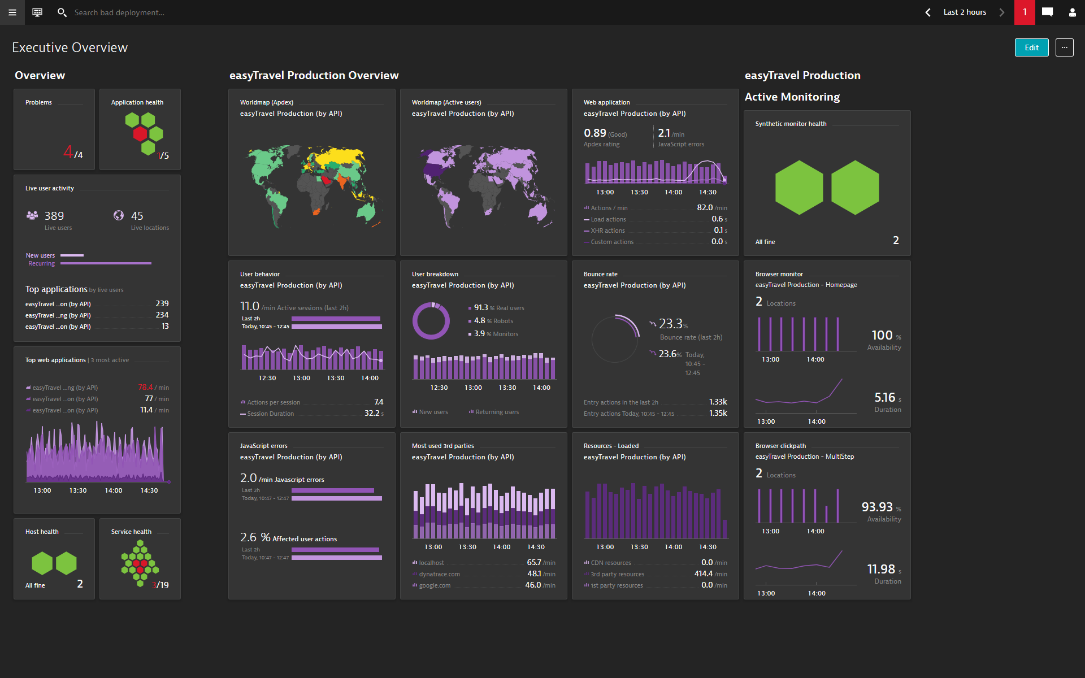
Notes:
We can export this and share between environments / customers in JSON format.
I will send you this. But what do you think would happen if I did this?

Slide 41
Synthetic API – Hands On
https://github.com/KevLeng/ConfigurationAPI-HandsOn
Follow Steps in Lab 3 – Dashboard API

Slide 42
Walk through….

Slide 43
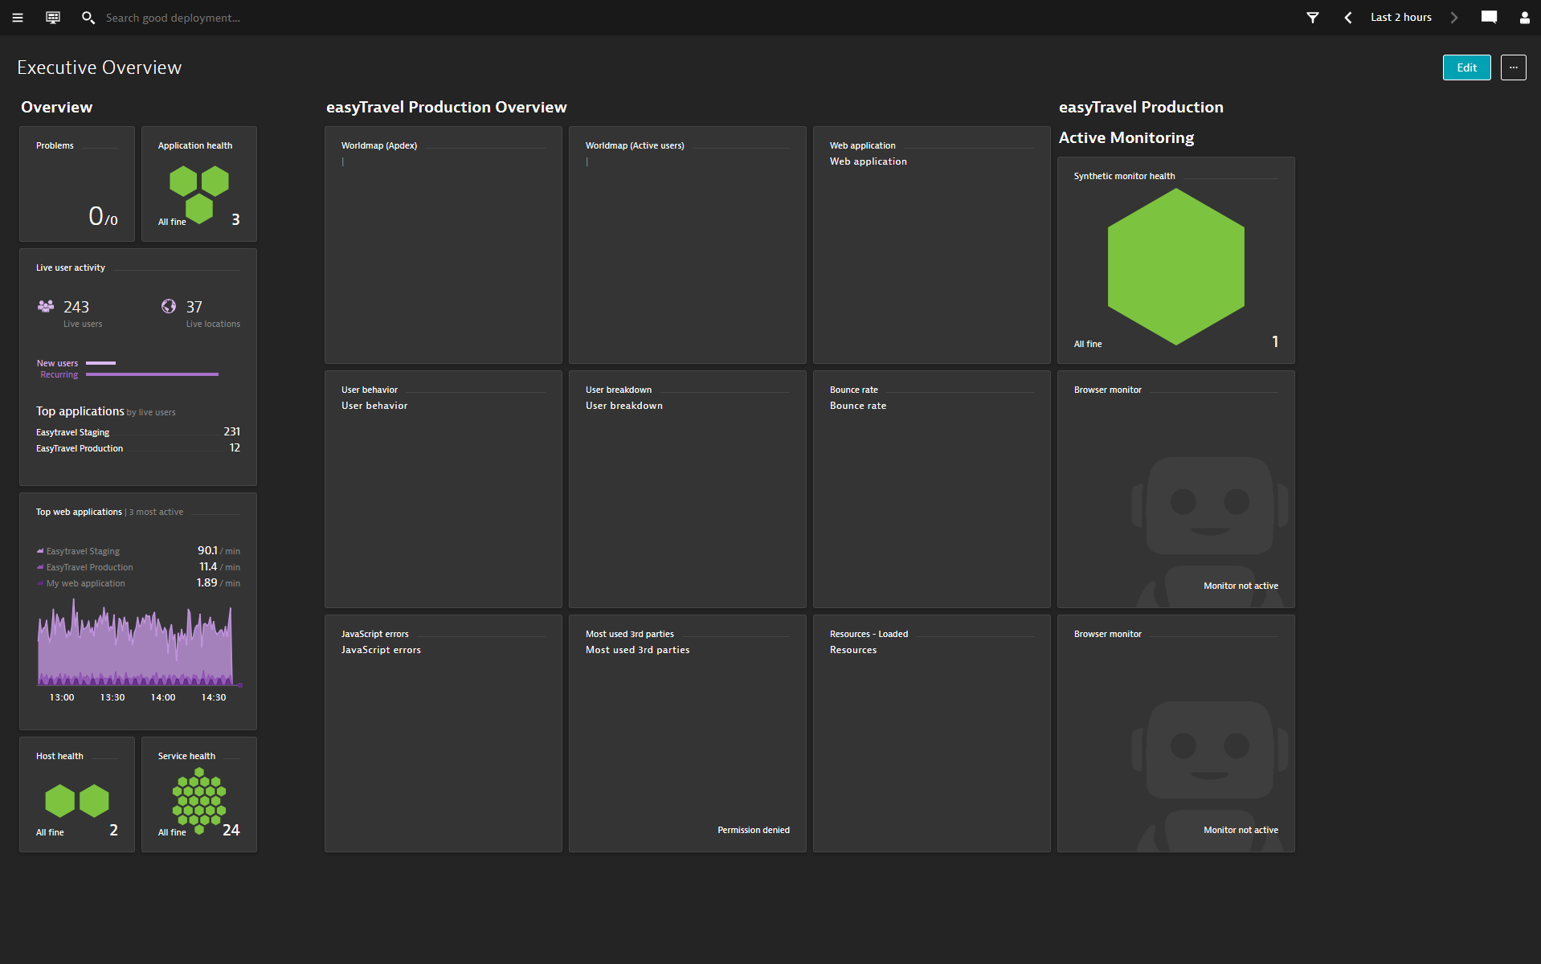
Notes:
Exempate im

Slide 44
Dashboards API
{
"metadata": {
"clusterVersion": "1.162.140.20190225-132002",
"configurationVersions": [
2
]
},
"id": "cd3dbb72-bd6b-4d3a-966b-ca07741b669b",
"dashboardMetadata": {
"name": "Executive Overview",
"owner": "admin",
"timeframe": "l_2_HOURS",
"managementZone": null
},
"tiles": [
{
"name": "Top web applications",
"tileType": "APPLICATIONS_MOST_ACTIVE",
"configured": true,
"bounds": {
"top": 494,
"left": 0,
"width": 304,
"height": 304
},
"useComparisionTimeframe": false,
"managementZone": null
With the Dashboard JSON:
Find: APPLICATION-B015199D5B489C02
Replace: with your application id of “easyTravel Production”
Find: SYNTHETIC_TEST-7C8DA81C3D924F91
Replace: with your synthetic id of your “easyTravel Homepage Browser Check”
Find: SYNTHETIC_TEST-7B366FE3C49E44B0
Replace: with your synthetic id of your “easyTravel Multi Step Browser Check”
Use resulting JSON to Create /dashboards using API
Example Script JSON

